Slide 1
Online Banking Website
Edubridge Mini Project
YuvaAjithan

Slide 2
Languages Used
HTML
CSS
Java Script

Slide 3
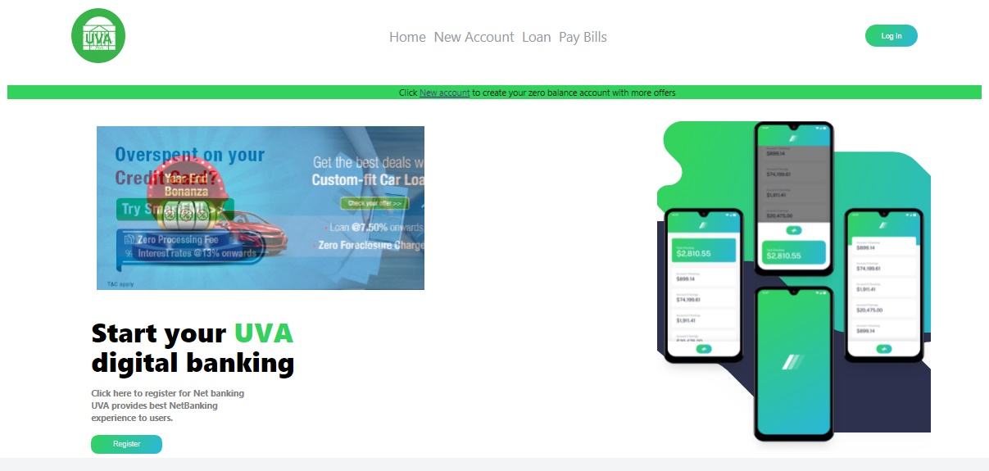
Home Page

Slide 4
Home Page:
A navigation bar with Logo and Log in button
Then I divided the header section in two parts one for backgroung Image
Another one division for registration button and Ads slide bar.
About us and Features Page:
Used Some Icons to show the different features provided by the bank like Loan , Insurance, Online Banking
For The about section I simply used one heading tag and paragraph tag.

Slide 5
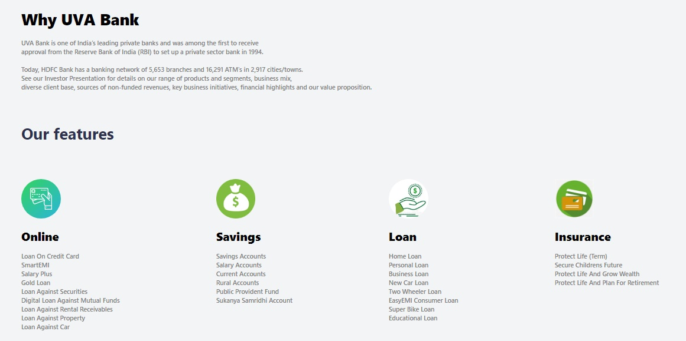
About Us and Features:

Slide 6
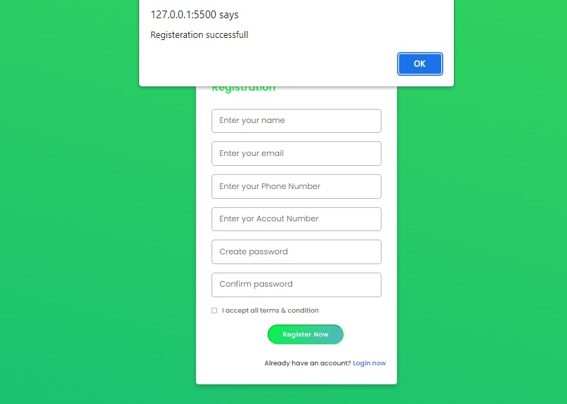
Registration form:
Here I used form for new account registration
Also used small JavaScript program to show the Successful Registration message in window pop up

Slide 7
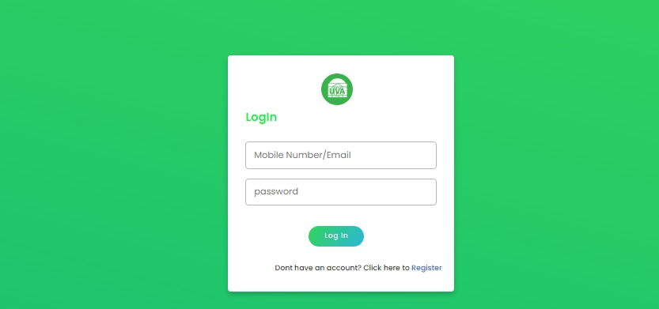
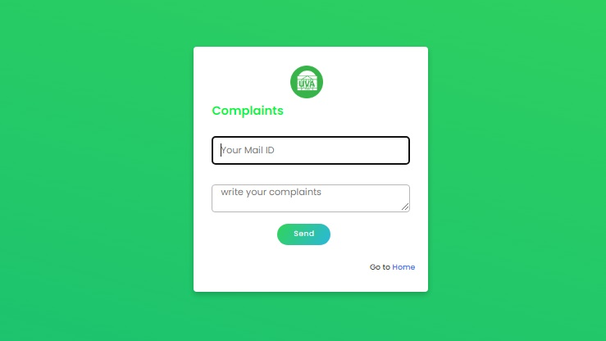
For both complaints page and login page I used form template with some text input tags and textarea to write complaints.
Log In Form:
Complaints Form:

Slide 8
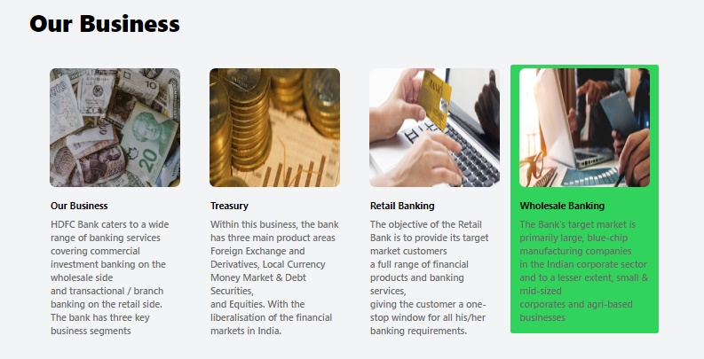
Bank business info Page:

Slide 9

Footer Division:
In this footer section I gave some social media links with Icons
And some basic footer menus like About , Contact us, Privacy Policy like that with Background color
Added one button to enable the users to write complaints directly to the bank admin

Slide 10
Thank You
tq

